Slide 1


Spotify
Recommendation
Model
Anita Gashi

Slide 2

Upgrade
John Doe
Welcome
About Us
Our Teams
Welcome
Agenda
Our Services
Spotify has been part of a wave of change in the music industry that has drastically affected how people buy and listen to music. Spotify is as much about social interaction and music exploration as it is a simple streaming service
Achievements
Our Goals
Gallery
Play
Follow
Pricing
Contact Us

Slide 3


Upgrade
John Doe
Welcome
About Us
Introduction
Our Teams
About Us
Agenda
Our Services
Achievements
Business Description
Our Goals
Spotify is a music streaming service, and was developed in Stockholm, Sweden in 2008, and went public as a company in 2018. As of 2018, Spotify provides access to 35 million songs, and has 180 million users worldwide, of which 83 million are paid subscribers. It is a freemium service, with most of its features available for free with advertisements, while its paid service removes ads and has additional features.
Gallery
Pricing
Contact Us

Slide 4
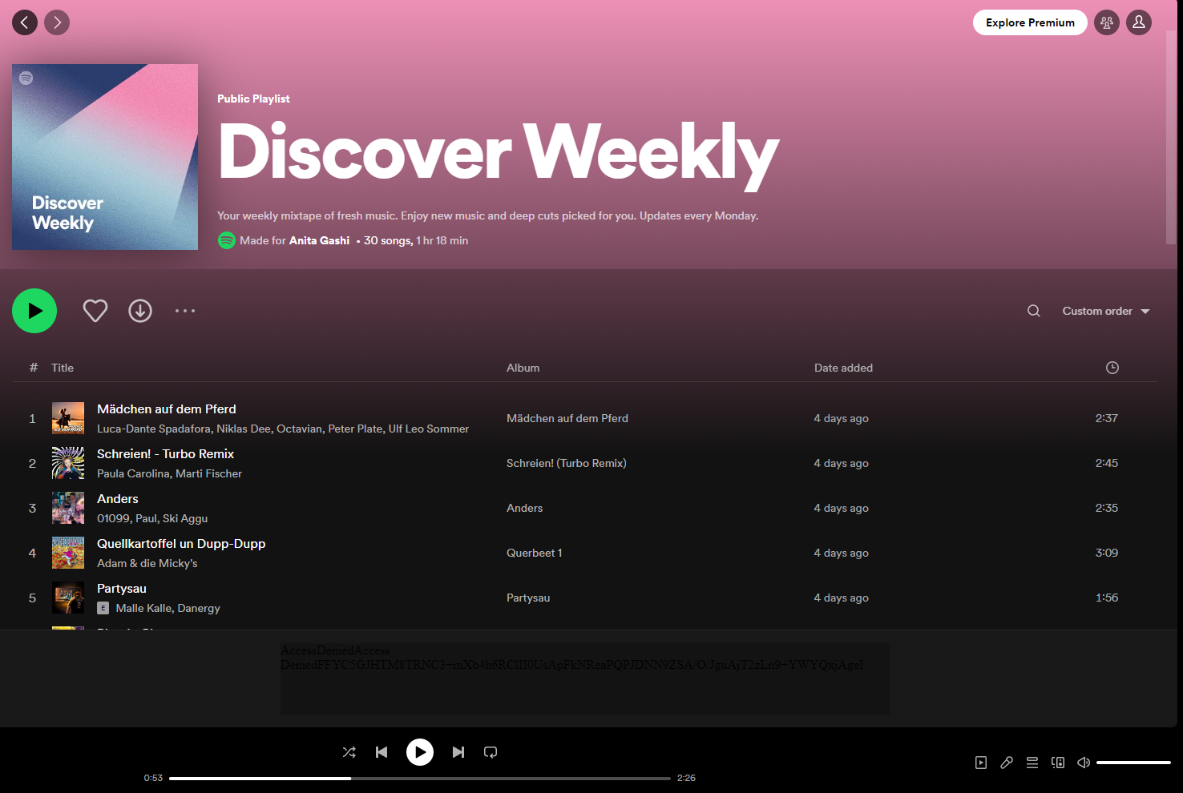
Upgrade
John Doe
Welcome
About Us
Our Teams
Discover Weekly
Agenda
Our Services
Discover Weekly is an amazing feature of Spotify: it is a 30-song weekly playlist provided to each paying user (some 80-million), customized to their specific tastes. The playlist has been such a hit with Spotify users, that the company is currently working on more algorithm-based playlists.
Achievements
Our Goals
Gallery
Pricing
Contact Us

Slide 5
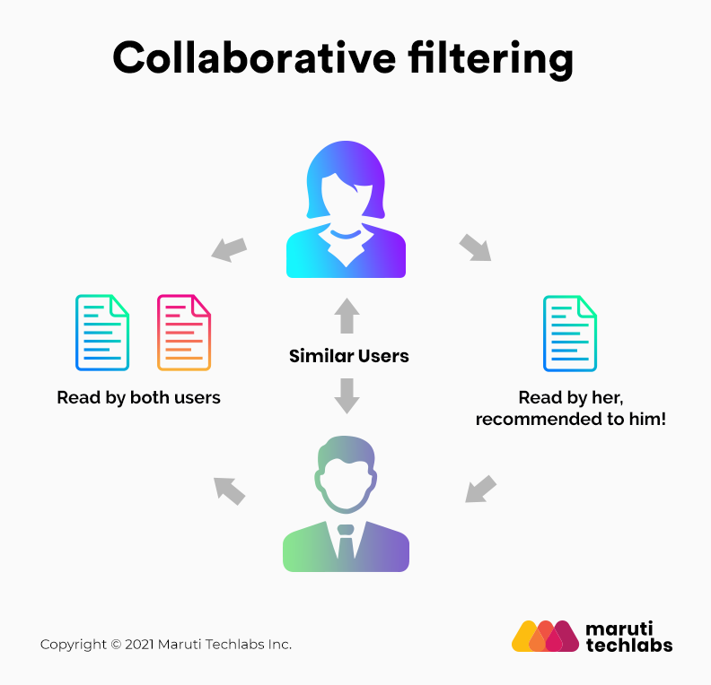
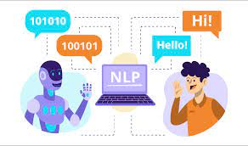
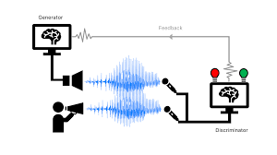
Upgrade
John Doe
Welcome
About Us
Our Teams
Three-Part Algorithm
Agenda
Our Services
Collaborative
Filtering
Natural Language Processing
Audio models
Achievements
Our Goals
Gallery
Pricing
Contact Us

Slide 6
Upgrade
John Doe
Welcome
About Us
Our Teams
Agenda
Our Services
Collaborative Filtering
Achievements
Our Goals
The basic assumption of collaborative filtering is that if Person 1 has the same opinion as Person 2 about an issue, then Person 1 is more likely to agree with Person 2 about another issue than they would a randomly selected person.
Collaborative filtering is a term that combines numerous methods with which a recommender system can be implemented .
What they all have in common is that direct or indirect user ratings about items are used to give an active user a personalized recommendation.
Gallery
Pricing
Contact Us

Slide 7
Upgrade
John Doe
Welcome
About Us
Our Teams
Agenda
Our Services
Natural Language Processing
Achievements
Our Goals
The way Spotify uses NLP is to determine the similarity of two pieces of music. Spotify will scour the web for blog posts and other music articles to develop a database of what is being said about certain artists. It is specifically looking for adjectives describing artists and songs, as well as which artists and songs are frequently mentioned together. Spotify then creates a database with these words (each artist potentially having thousands of descriptive words) and weights them based on importance, or the probability that someone will use that word to describe an artist. Spotify then uses these weighted words to determine the similarity of pieces of music to further enhance their recommendation process.
Gallery
Pricing
Contact Us

Slide 8

Upgrade
John Doe
Welcome
About Us
Our Teams
Agenda
Our Services
Audio models
Achievements
Our Goals
This third model analyzes raw audio data. Spotify uses convolutional neural networks (the same technology used by facial recognition software) to process song data, and provides them with characteristics about a song, such as tempo, volume, key, and time signature. This gives Spotify an additional layer of data with which to use to compare and contrast certain songs.
Gallery
Pricing
Contact Us

Slide 9
Upgrade
John Doe
Welcome
About Us
Our Teams
Agenda
Where else can be applied these algorithms
Our Services
Amazon:
Now the idea of providing users with personalized suggestions isn’t new: Amazon’s “customers who
bought x might also like y” feature has been around for years.
Netflix
One of the more popular applications of collaborative filtering
Netflix’s star-based movie system.
How certain users rated certain movies would provide Netflix information about which other users would probably like the movie.
Unlike Netflix, Spotify doesn’t have a star system. Rather, their metrics for popularity are streams, as well as whether a user visited the Artist’s page or saved the song to a playlist
Achievements
Our Goals
Gallery
Pricing
Contact Us

Slide 10


Thank You
Despacito
Luis Fonsi, Daddy Yankee
0:23
-3:25

